Slide 1
How to Create Solutions for Relativity & ADS Solutions

Slide 2
Chandra Alimeti
Michael Masanek

Slide 3
Dev VM Setup
Starting Development
Logging
How to Override New Button Link for an RDO
How to Override Edit Link for an RDO
Publish to Relativity Console
Visual Studio Post-Publish Event
Object Manger API
Gravity API
Unit Tests
Versioning

Slide 4
Getting Started

Slide 5
You should see a PDF on your workshop machine’s desktop.
This document contains all the instructions for today’s workshop.
Workbook
Document

Slide 6
Follow instructions on Section 2.1 on Page 4 to access the Visual Studio project.
Visual Studio Project

Slide 7
Follow instructions in Section 2.2 on Page 6 to setup DevVM for accessing Relativity.
DevVM Setup

Slide 8
Starting Development

Slide 9
Creating a Relativity Application
Develop a Relativity Event Handler
Manual
Visual Studio Template
Publish to Relativity
Section Overview

Slide 10
Extend Relativity
Customized workflows
Custom Objects (RDOs)
Extensibility Points
Event Handlers
Agents
Custom Pages
Exportable to other workspaces/instances
Relativity Applications
Overview

Slide 11
Customize workflows
Code execution at different events
Pre/post save
Pre/post install
Page interaction
Inherit from a base class
Other ways to customize
Agents – background processes
Custom page – customize UI
Event Handler Overview

Slide 12
Pre-created class files
Auto-filled class attributes
GUID
Execution type
Overridable functions
Version specific
Generally work across versions
Downloaded from Visual Studio Gallery
Visual Studio Templates

Slide 13
Quickly upload application files
Resource files
Custom pages
That’s about it
Publish to Relativity

Slide 14
Starting Development
Section 3 Page 11

Slide 15
Create a Relativity Application
"Build your first application"
Develop a Relativity Event Handler
"Build your first event handler"
Visual Studio Templates
"Visual Studio templates"
Publish to Relativity
"Publish to Relativity tool"
Documentation
References

Slide 16
Logging

Slide 17
Logging overview
Logging in Relativity applications
Section Overview

Slide 18
Uses
Troubleshooting
Debugging
Deleted on a regular basis
Not for auditing!
Various levels
Error
Warning
Debug
Administrators logging system
Logging Overview

Slide 19
Relativity.Api.IAPILog
Methods for each level
Things to log
API Calls
SQL
Entry/exit points
Use ForContext<MyEventHandler>
Logging in Relativity Applications

Slide 20
Logging
Section 4 Page 21

Slide 21
Logging overview
"Logging"
Logging from extensibility point
"Log from a Relativity Application"
Documentation
References

Slide 22
Customize New Button Override & Override Edit Link URL Object Rules

Slide 23
Custom page
Publish To Relativity console
Visual Studio post-publish build event
RSAPI
Object Manager API
Gravity API
Object rules
New button override
Override edit link URL
Section
Overview

Slide 24
Custom Page

Slide 25
It’s a pre-built ASP.NET MVC 5 web application
Contains two views to create and edit a RDO record
NewRdo
EditRdo
API helper classes
RSAPI
ObjectManager API
Gravity API
RDO model with custom RegEx validations
Custom Page

Slide 26
Publish To Relativity Console

Slide 27
Open source project on Github
https://github.com/relativitydev/publish-to-relativity-console
Console application that takes various arguments to programmatically push resource files and custom pages to a Relativity application
Publish To Relativity Console

Slide 28
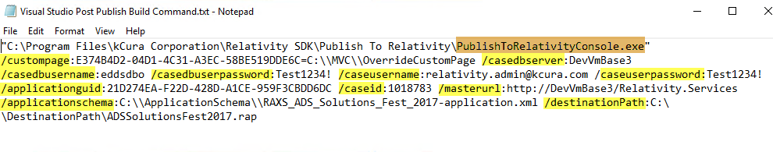
Publish To Relativity Console Arguments

Slide 29
Publish To Relativity Console Arguments
Argument | Description
/custompage: E374B4D2-04D1-4C31-A3EC-58BE519DDE6C=C:\\MVC\\OverrideCustomPage | Custom page GUID and path
/casedbserver:DevVmBase3.mshome.net | SQL Server name
/casedbusername:eddsdbo | SQL Server login
/casedbuserpassword:Test1234! | SQL Server password
/caseusername:relativity.admin@kcura.com | Relativity admin username
/caseuserpassword:Test1234! | Relativity admin password
/applicationguid: 21D274EA-F22D-428D-A1CE-959F3CBDD6DC | Application GUID
/caseid:1024846 | Workspace Artifact ID
/masterurl:http://DevVmBase3.mshome.net/Relativity.Services | RSAPI URL
/applicationschema:C:\\ApplicationSchema\\RAXS_ADS_Solutions_Fest_2017-application.xml | Application Schema Path
/destinationPath:C:\\DestinationPath\\ADSSolutionsFest2017.rap | Generated RAP file path

Slide 30
Visual Studio Post-Build Event

Slide 31
Custom build event
Automatically runs commands after it finishes building
Visual Studio Post-Build Event

Slide 32
Object Rules

Slide 33
Relativity-provided action that permits special or additional functions with user-configurable options
Rules used in workshop
New button override
Override edit link URL
Object Rules

Slide 34
ObjectManager API

Slide 35
ObjectManager API is the API that will replace RSAPI and REST API in the near future.
Functionality currently available
Create for Document/RDO
Read for Document/RDO
Update for Document/RDO
Query for Document/RDO
Functionality currently being added
Delete for Document/RDO
Also has a REST based API endpoint
ObjectManager API

Slide 36
Gravity API

Slide 37
Developed by TSD
https://www.tsd.com/
Open source project on Github
https://github.com/tsdservices/gravity
CRUDQ Framework for Relativity Custom Development using .NET objects
Easy to work with as data is returned in the form of .NET objects; all the field conversions are done for you by Gravity.
Prevent any future issues caused by changes in Relativity APIs
NuGet package
https://www.nuget.org/packages/Gravity/
Gravity API

Slide 38
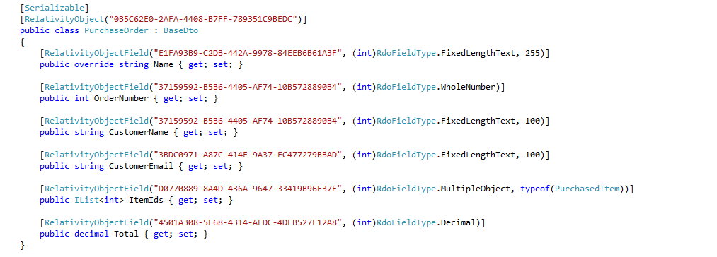
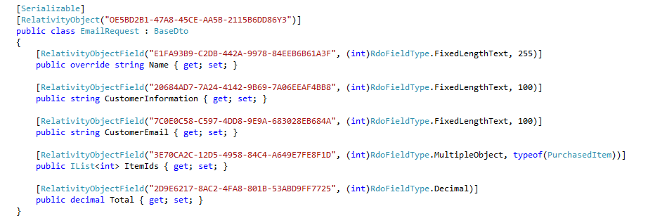
Example Models – PurchaseOrder & EmailRequest

Slide 39
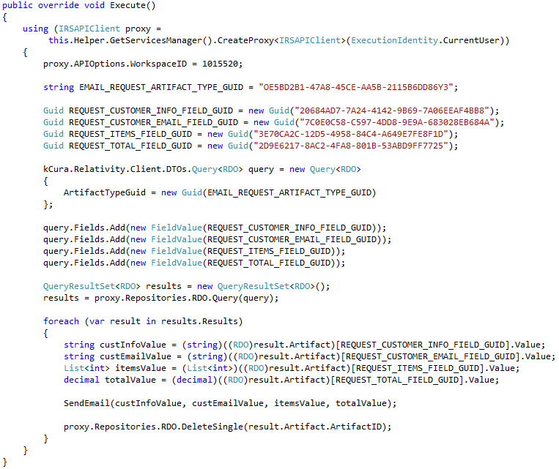
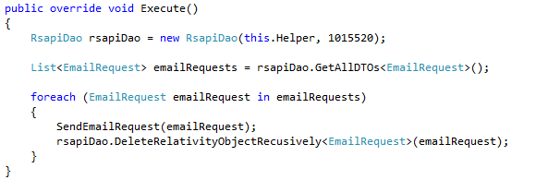
Before Gravity vs. After Gravity – (Agent Example)

Slide 40
PR134246 - Gravity: A New, Open Framework for Relativity Developers
German Gachevski
Mark Robustelli
Tuesday, Oct 24, 11:00 AM - 12:00 PM
Room: Salon A2
Need more information? Stop by TSD’s booth.
Fest Session

Slide 41
Customize New Button Override & Override Edit Link URL Object Rules
Section 5 Page 25

Slide 42
Unit Tests

Slide 43
Find software bugs early
Facilitates change
Simplifies integration
Provides documentation
Unit Tests

Slide 44
Necessary to verify whether the software modules work in unity
Test custom applications when new versions of Relativity are released
RelativityOne and integration tests
Relativity test helpers for integration tests
Open source project on Github
https://github.com/relativitydev/relativity-test-helpers
Integration Tests

Slide 45
PR127884 - This is Only a Test: Best Practices for Validating Agents, Scripts and Event Handlers
Priya Pande
Erik Riggenbach
Wednesday, Oct 25, 9:45 AM - 10:45 AM
Room: PDR 2
Fest Session

Slide 46
Unit Tests
Section 6 Page 56

Slide 47
Versioning

Slide 48
Versioning Schema

Slide 49
Process of incrementally adding new functionality
Upgrade considerations
SQL schema changes
Object changes
New fields or renames
Relativity versions
Application Updates

Slide 50
Most application objects have a
GUID
Version
Changes applied when
GUID = GUID
Current version < new version
GUID/version workspace specific
"Golden Workspace"
Origin Signature
Versioning Schema

Slide 51
Versioning Resource Files
Not versioned like schema objects
Uses file hash
Export packages all files in the system
Delete PBDs before release
Resource file removal
Pre – 9.5.253.62
Keeps all files
Can lead to upgrade errors
Post – 9.5.253.62
Forcibly remove files

Slide 52
Versioning Source Code

Slide 53
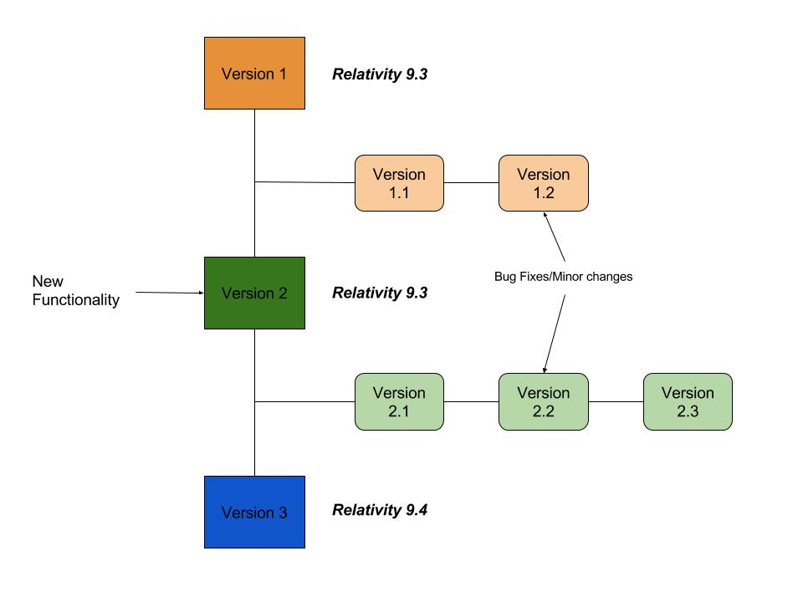
Managing Various Versions of a Relativity Application

Slide 54
Relativity Community (community.relativity.com)
Developer Group
DevHelp Community (devhelp.relativity.com)
RelativityDev GitHub (relativitydev.github.io)

Slide 57
Questions?

